Slide 1

Sentiment Analysis using Machine Learning
Submitted By
Vipparthy Niharika (17071A12B6)
Ramya Achanta (17071A1261)

Slide 2

CONTENTS
ABSTRACT
REQUIREMENTS
INTRODUCTION
ALGORITHM DISCRIPTION
UML DIAGRAMS
IMPLEMENTATION
CONCLUSION
FUTURE SCOPE
BIBLIOGRAPHY

Slide 3
ABSTRACT
Sentiment analysis is extremely useful in social media monitoring as it allows us to gain an overview of the wider public opinion behind certain topics. Classification algorithms in supervised machine learning are used to predict the label of a given “data” as positive or negative based on its content. The text data is converted from the perception of a mode of expression to semantically equivalent numeric format so as to be used for training, testing and as input for the machine learning model developed. The client’s requirement of understanding sentiment among twitter or imdb or any other site’s users who may be consumers, viewers or any service receivers from the client’s entity is the key objective of this case study.

Slide 4

requirements
System Requirements:
Jupyter Notebook
Sample dataset (IMDB reviews)
Python API’s & Libraries required
Pandas
Matplotlib
NumPy
Seaborn
Re
nltk
Pickle

Slide 5

INTRODUCTION
Machine learning is an application of artificial intelligence (AI) that provides systems the ability to automatically learn and improve from experience without being explicitly programmed.
Types of learning:
1.Supervised
2.Unsupervised
Types of supervised-learning:
1.Classification(defined labels)
2.Regression(no defined labels)
Examples of Supervised-learning algorithms:
1.KNN
2.Guassian Naïve-Bayes
3.Decision Trees
4.Support Vector Machine(SVM)
5.Random Forest

Slide 6
ALGORITHM DESCRIPTION
Sentiment analysis is a machine learning tool that analyzes texts for polarity, from positive to negative. By training machine learning tools with examples of emotions in text, machines automatically learn how to detect sentiment without human input.
Classifier Logistic Regression
Logistic regression is a statistical model that in its basic form uses a logistic function to model a binary dependent variable, although many more complex extensions exist. In regression analysis, logistic regression (or logit regression) is estimating the parameters of a logistic model (a form of binary regression).
In the case of this project, review acts as the independent variable and sentiment is the dependent variable.

Slide 7
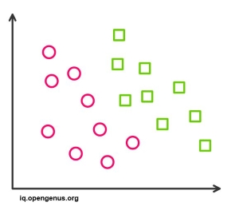
Advantages of Logistic Regression Classifier
Logistic Regression is one of the simplest machine learning algorithms and is easy to implement yet provides great training efficiency in some cases. Also due to these reasons, training a model with this algorithm doesn't require high computation power.
The predicted parameters (trained weights) give inference about the importance of each feature. The direction of association i.e. positive or negative is also given. So we can use logistic regression to find out the relationship between the features.
This algorithm allows models to be updated easily to reflect new data, unlike decision trees or support vector machines. The update can be done using stochastic gradient descent.

Slide 8
Logistic Regression outputs well-calibrated probabilities along with classification results. This is an advantage over models that only give the final classification as results. If a training example has a 95% probability for a class, and another has a 55% probability for the same class, we get an inference about which training examples are more accurate for the formulated problem.
In a low dimensional dataset having a sufficient number of training examples, logistic regression is less prone to over-fitting.
Rather than straight away starting with a complex model, logistic regression is sometimes used as a benchmark model to measure performance, as it is relatively quick and easy to implement.
Logistic Regression proves to be very efficient when the dataset has features that are linearly separable.

Slide 9
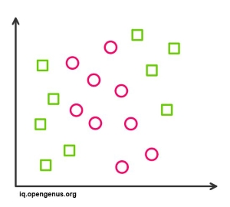
Disadvantages of Logistic Regression Classifier
Logistic Regression is a statistical analysis model that attempts to predict precise probabilistic outcomes based on independent features. On high dimensional datasets, this may lead to the model being over-fit on the training set, which means overstating the accuracy of predictions on the training set and thus the model may not be able to predict accurate results on the test set. This usually happens in the case when the model is trained on little training data with lots of features. So on high dimensional datasets, Regularization techniques should be considered to avoid over-fitting (but this makes the model complex). Very high regularization factors may even lead to the model being under-fit on the training data.
Non linear problems can't be solved with logistic regression since it has a linear decision surface. Linearly separable data is rarely found in real world scenarios. So the transformation of non linear features is required which can be done by increasing the number of features such that the data becomes linearly separable in higher dimensions.

Slide 10
Logistic Regression classifier Applications
Examples -Email : Spam / not Spam ? , Online Credit Card Transactions : Fraudulent (Yes/No)
In the Trauma and Injury Severity Score (TRISS), it is widely used to predict mortality in injured patients, was originally developed by Boyd et al. using logistic regression. Many other medical scales used to assess severity of a patient have been developed using logistic regression.
Logistic regression may be used to predict the risk of developing a given disease (e.g. diabetes; coronary heart disease), based on observed characteristics of the patient (age, sex, body mass index, results of various blood tests, etc.).
To predict whether a Nepalese voter will vote Nepali Congress or Communist Party of Nepal or Any Other Party, based on age, income, sex, race, state of residence, votes in previous elections, etc.
The technique can also be used in engineering, especially for predicting the probability of failure of a given process, system or product.
It is also used in marketing applications such as prediction of a customer's propensity to purchase a product or halt a subscription, etc.
In economics it can be used to predict the likelihood of a person's choosing to be in the labour force, and a business application would be to predict the likelihood of a homeowner defaulting on a mortgage. Conditional random fields, an extension of logistic regression to sequential data, are used in natural language processing.
Notes:
Decision tree Applications
Biomedical Engineering (decision trees for identifying features to be used in implantable devices).
Financial analysis (Customer Satisfaction with a product or service).
Astronomy (classify galaxies).
System Control.
Manufacturing and Production (Quality control, Semiconductor manufacturing, etc).
Medicines (diagnosis, cardiology, psychiatry).
Physics (Particle detection).

Slide 11
UML Diagrams
Unified Modelling Language is a tool that helps a designer to present his ideas about the project to his client and his developer. Modelling plays a crucial role in designing a software. A poorly designed model can lead to a poorly developed software. A UML system has using five different views that help in describing systems from different perspectives. Each view has a set of diagrams that and components that represent the real time objects.
a. User Model View:
It models the user behaviour in a system context.
All the diagrams are drawn keeping in mind the user’s response and reaction towards a system.
b. Structural Model View
This view consists of class diagram and object diagram which is used to model the static structures.
It uses objects, attributes, operations and relationships.

Slide 12
. Behavioural Model View
It mainly consists of the sequence diagram, collaboration diagram, state chart diagram and activity diagram. They mainly represent flow of actions between different objects involved in the system
They are used to visualize various dynamic aspects of the system architecture.
d. Implementation Model View
This view consists of component diagrams and deployment diagrams. This view models the static software modules for an organization.
This usually contains the data files, documentation, the executables and source code.
These are the physically replaceable components of the system. They are modelled using component

Slide 13
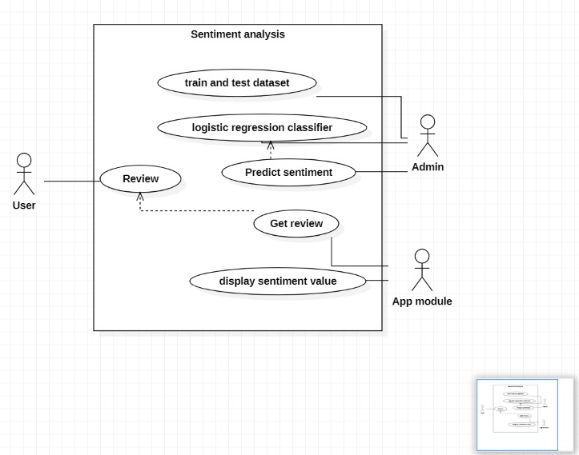
Use Case Diagram:

Slide 14
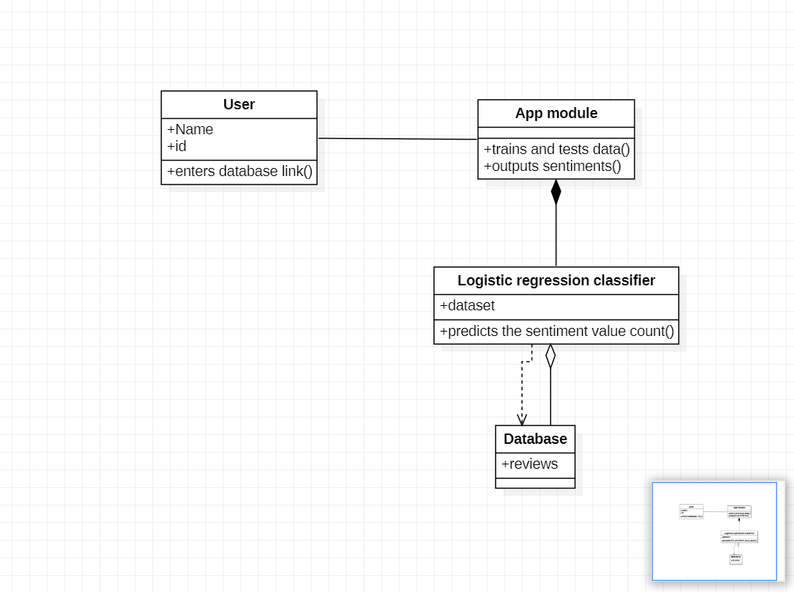
Class Diagram:

Slide 15
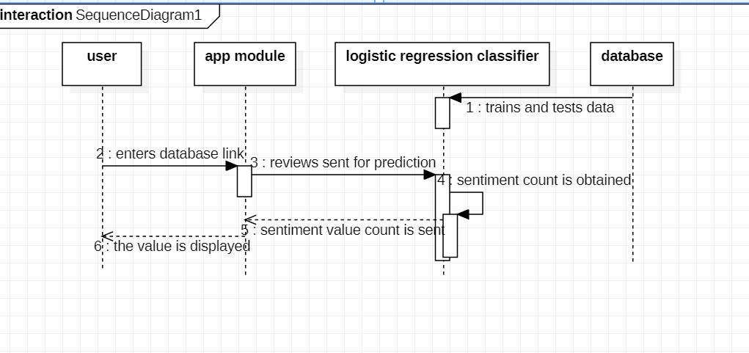
Sequence Diagram:

Slide 16
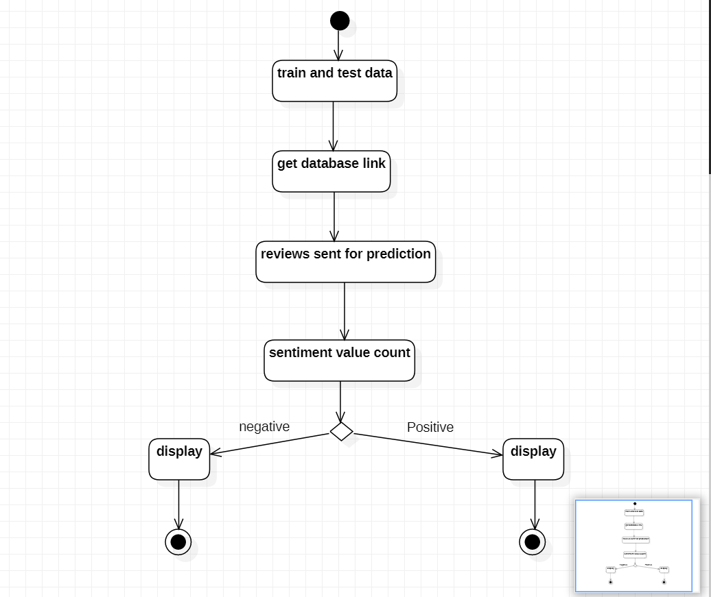
Activity Diagram:

Slide 17
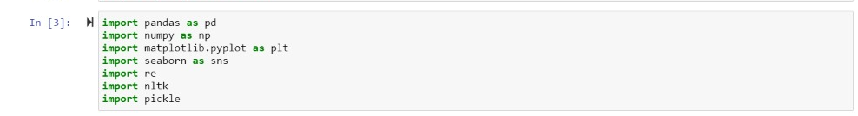
implementation
Code for loading dataset and Importing Libraries
Numpy, Pandas, pickle and matplotlib, seaborn and nltk libraries are imported. Pickle library reduces the task of loading datasets and training algorithm every time the program is executed.

Slide 18
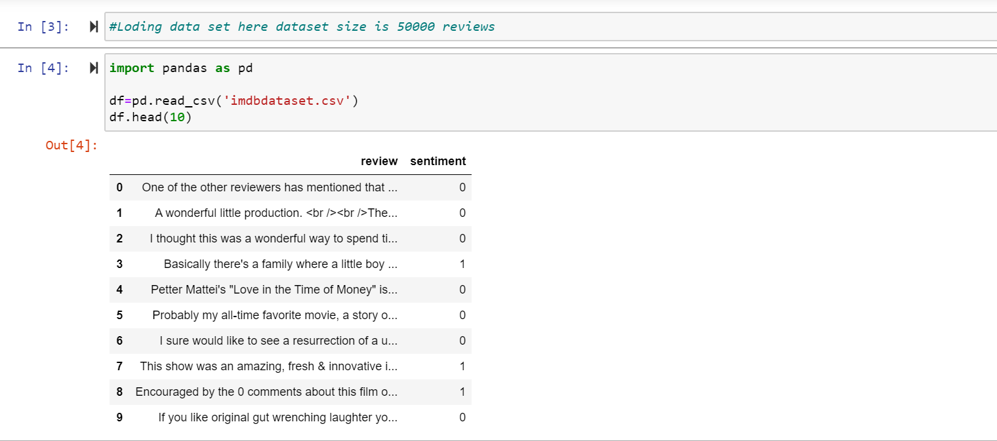
Loading the data set.

Slide 19
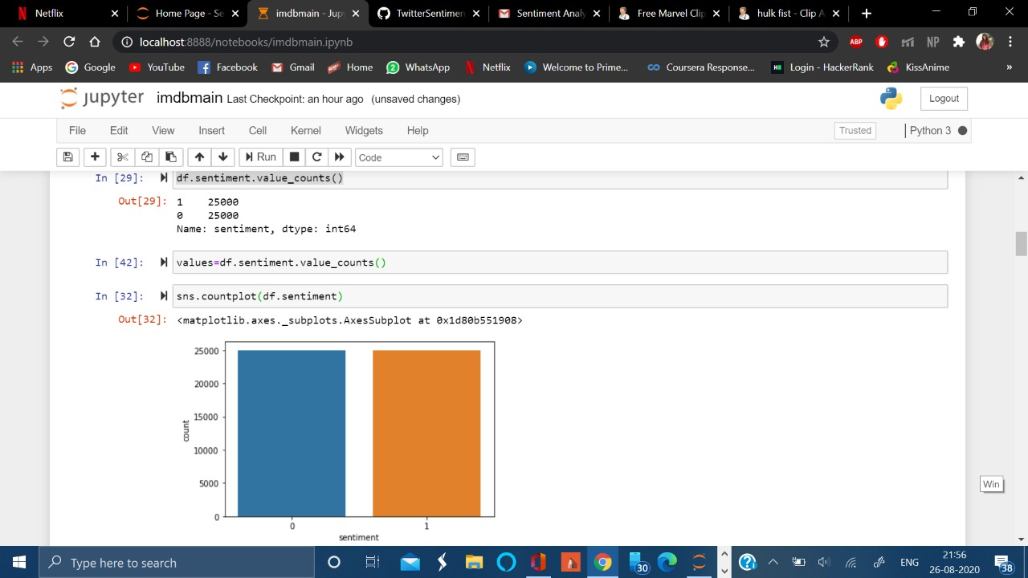
We use the following command to check the sentiment count value of each sentiment in the dataset.
As we can see, the data is equally balanced between positive and negative sentiments.
Graphical representation of the sentiment value count.

Slide 20
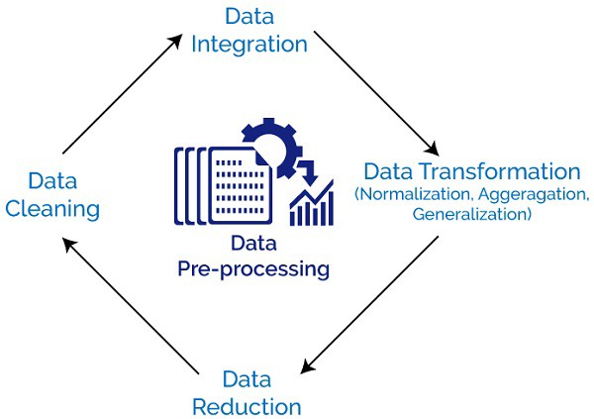

Slide 21
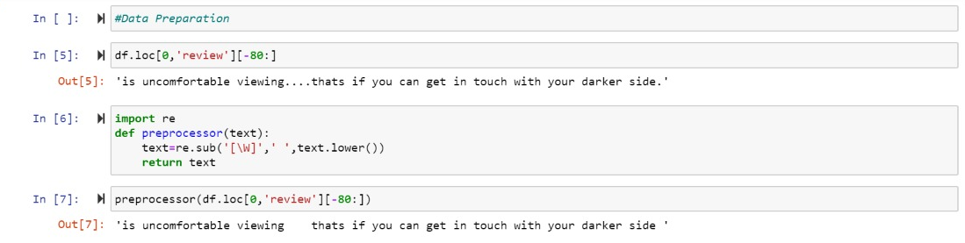
The data is prepared and unwanted symbols are removed using the user-defined function called preprocessor.

Slide 22
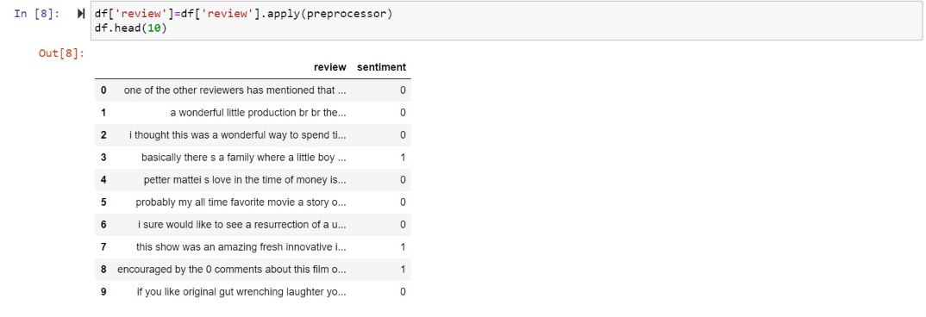
The data is printed after applying the preprocessor function.

Slide 23
Cleaning Data
We use a user defined function called clean in which we are tokenizing the data, removing the stop words and stemming the data.
Tokenizing - we will tokenize all the cleaned reviews in our dataset. Tokens are individual terms or words, and tokenization is the process of splitting a string of text into tokens using word_tokenize in built function.
Stemming - is a rule-based process of stripping the suffixes (“ing”, “ly”, “es”, “s” etc) from a word. For example — “play”, “player”, “played”, “plays” and “playing” are the different variations of the word — “play”
Stopwords - are the English words which do not add much meaning to a sentence. They can safely be ignored without sacrificing the meaning of the sentence. For example, the words like the, he, have etc. Such words are already captured this in corpus named corpus.
The aforementioned methods are applied using nltk(natural language took kit)

Slide 24
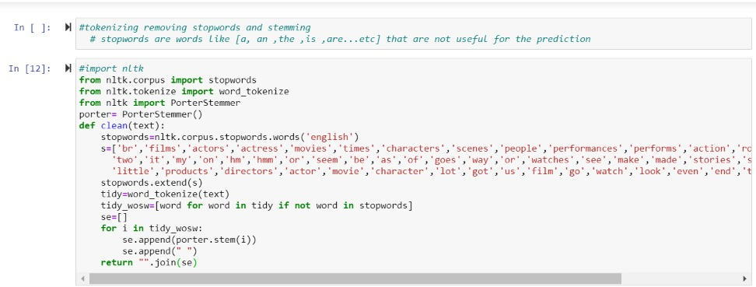
Input :

Slide 25
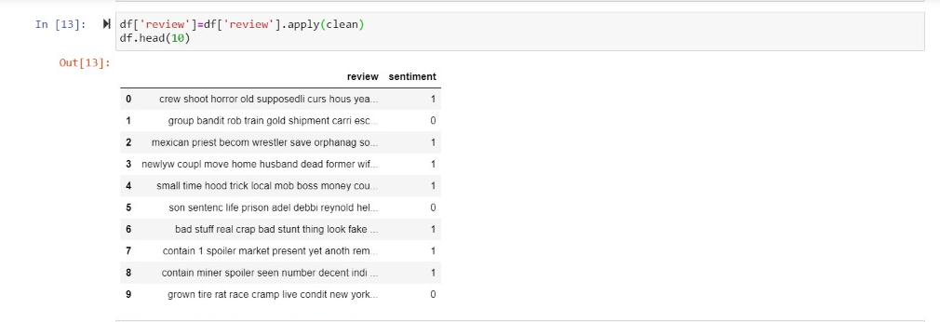
Output:

Slide 26
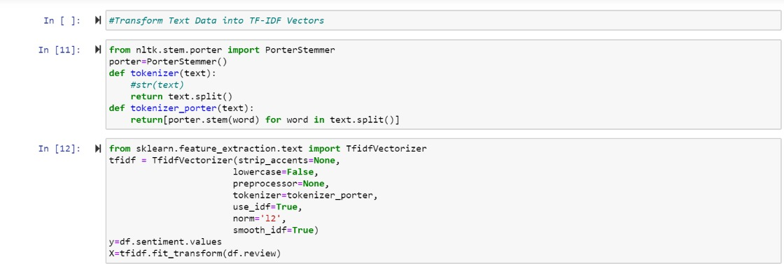
Information retrieval
In information retrieval, tf–idf or TFIDF, short for term frequency–inverse document frequency, is a numerical statistic that is intended to reflect how important a word is to a document in a collection or corpus.
Datasets are imported and then the data set is split into two sets X and Y.
X contains the set of reviews and Y contains sentiment values for the corresponding review..

Slide 27
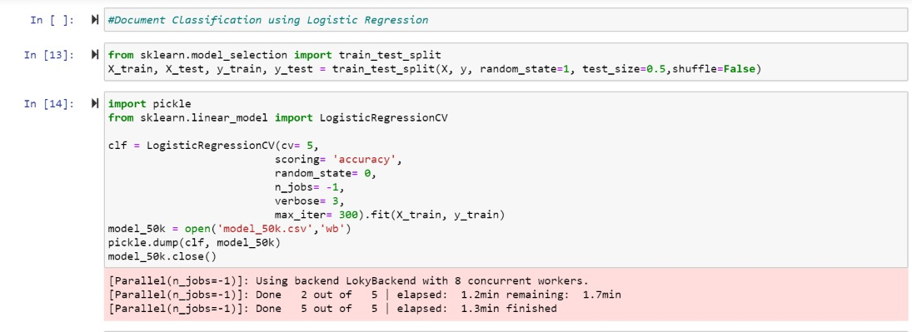
Classification using logistic regression

Slide 28
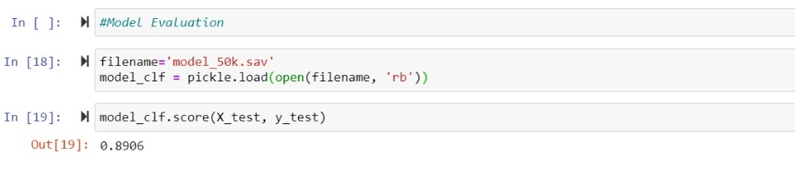
Model Evaluation
Evaluating the model’s accuracy after classification of the data

Slide 29
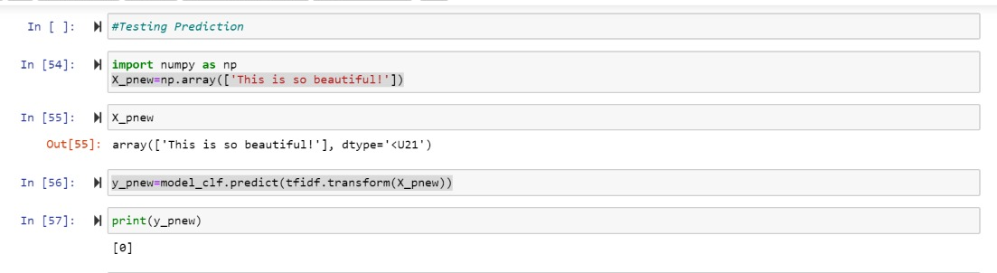
Sentiment Prediction
Predicting the sentiment value for a positive review.

Slide 30
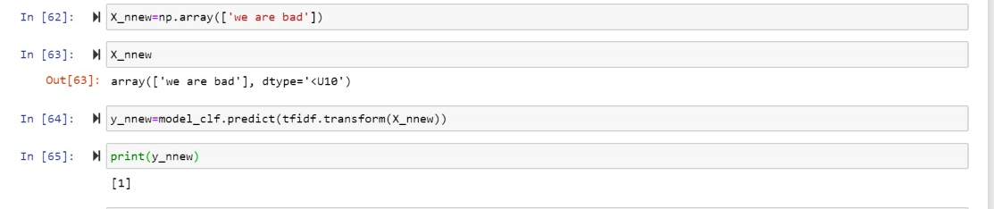
Predicting the sentiment value for a negative review.

Slide 31
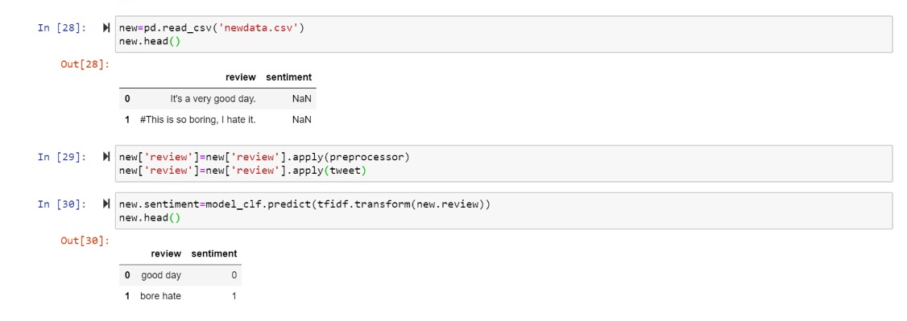
Predicting sentiment for multiple reviews

Slide 32
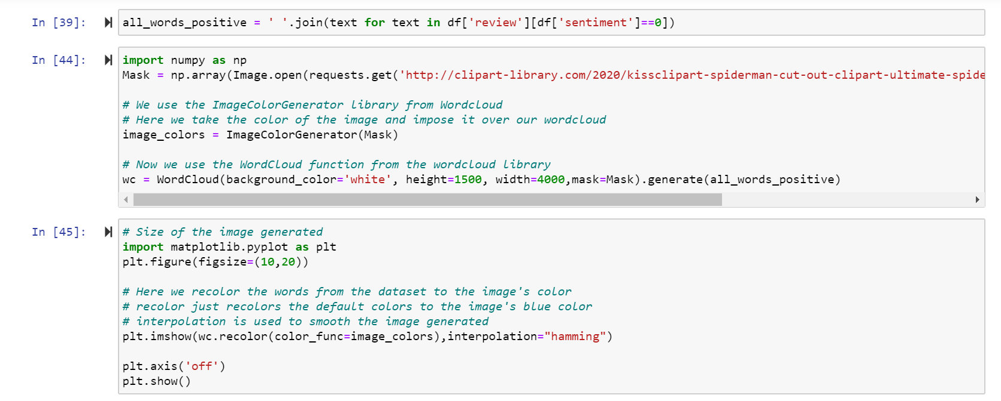
Data Visualization
For positive reviews:

Slide 33
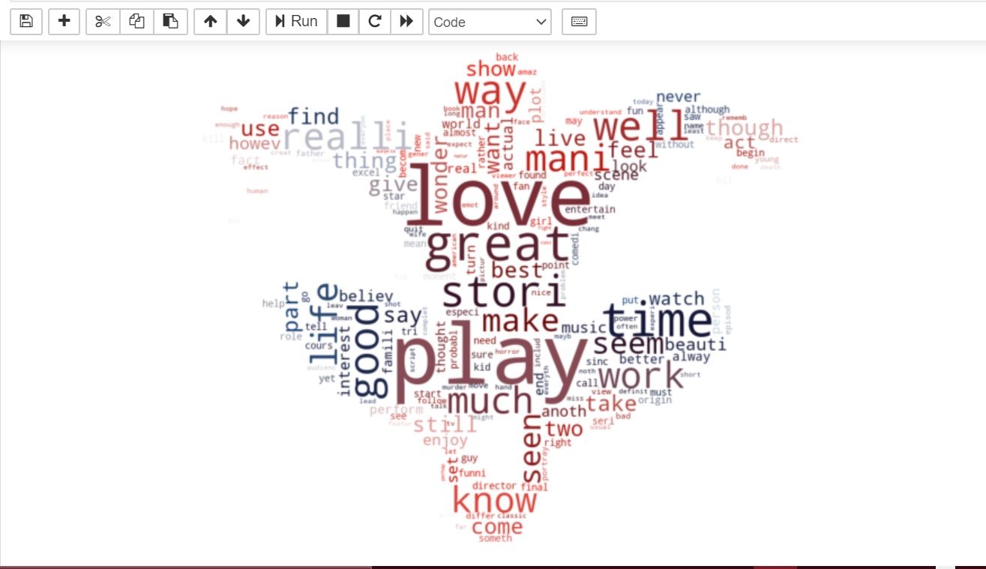
The words that are repeated maximum number of times are printed.

Slide 34
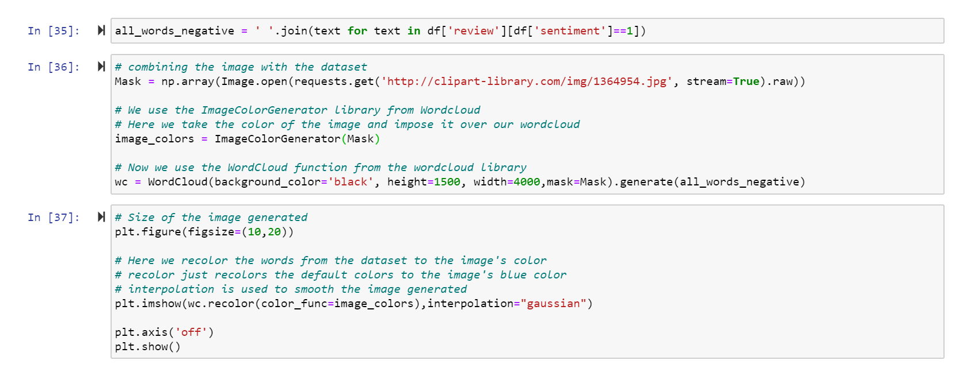
For negative reviews:

Slide 35
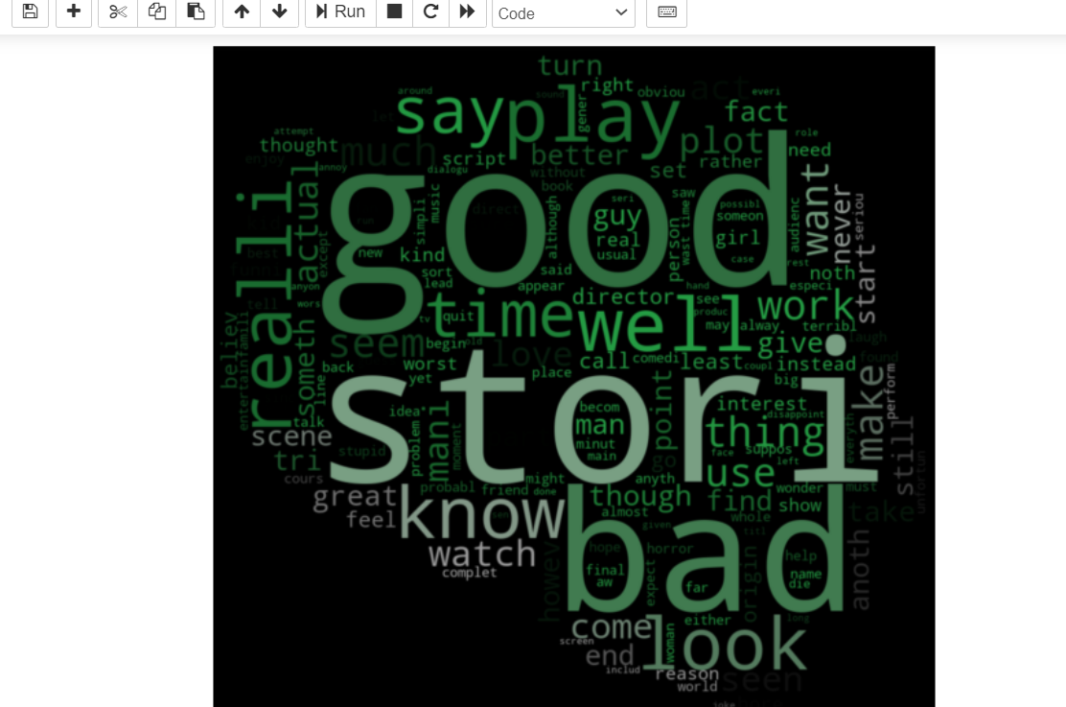
The words that are repeated maximum number of times are printed.

Slide 36
Conclusion
In conclusion of this case study, a machine learning model using Logistic Regression algorithm is built for a client whose purpose is to analyze the public response through sentiment analysis on a particular topic (on twitter platform). Sentiment analysis can be done by brands for market response on certain products, a film or book response, the sentiment around socialist movement etc.; can be observed by the client successfully and the generated reports and predictions can be effectively tackled by taking their respective domain related measures accordingly.
Example: Analysis performed on “feminist movement” in a case study taken from twitter dataset can be used to understand the extent of debatability of the topic and plan news programs and panels accordingly.
Notes:
The algorithm can further be

Slide 37

Future Scope
Future opinion-mining systems need broader and deeper common- and common-sense knowledge bases. This will lead to a better understanding of natural language opinions and will more efficiently bridge the gap between multimodal information and machine processable data. Blending scientific theories of emotion with the practical engineering goals of analysing sentiments in natural language text will lead to more bio-inspired approaches to the design of intelligent opinion-mining systems capable of handling semantic knowledge, making analogies, learning new affective knowledge, and detecting, perceiving, and “feeling” emotions.

Slide 38
BIBLIOGRAPHY
References:
Couresea Project on sentimental analysis using ML
https://scikit-learn.org/stable/modules/generated/sklearn.linear_model.LogisticRegression.html https://en.wikipedia.org/wiki/Tf%E2%80%93idf#:~:text=In%20information%20retrieval%2C%20tf%E2%80%93idf,in%20a%20collection%20or%20corpus. https://towardsdatascience.com/social-media-sentiment-analysis-49b395771197
https://en.wikipedia.org/wiki/Tf%E2%80%93idf#:~:text=In%20information%20retrieval%2C%20tf%E2%80%93idf,in%20a%20collection%20or%20corpus.
https://towardsdatascience.com/social-media-sentiment-analysis-49b395771197

